Slide 1
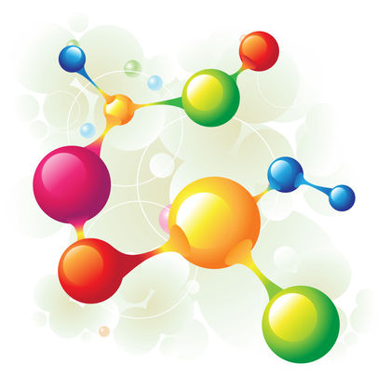
Topics
1) Nuclear spin-spin coupling in paramagnetic systems.
2) Obtaining g-tensors from unrestricted determinants.
3) G-tensor theory for strong spin-orbit coupling.

Slide 2
G-tensor theory and strong spin-orbit coupling
Single molecular magnets often involve multiple heavy metal nuclei.
Relativistic methods are becoming more necessary and computationally viable.
Q) How well is g-tensor theory adapted to cases with strong spin-orbit coupling?

Slide 3
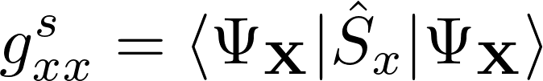
Consistent rotations
Should get the same g-tensor regardless of the orientation of the spin used in the calculation, e.g.,

Slide 4
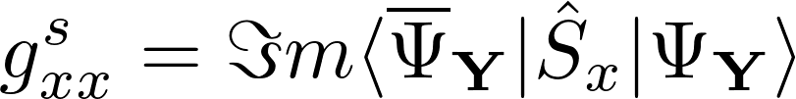
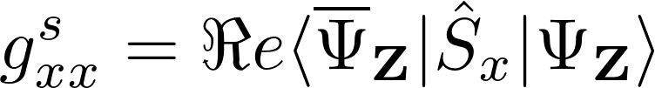
Consistent rotations
Should get the same g-tensor regardless of the orientation of the spin used in the calculation, e.g.,

Slide 5
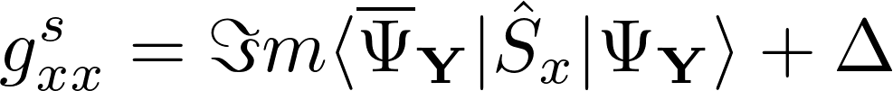
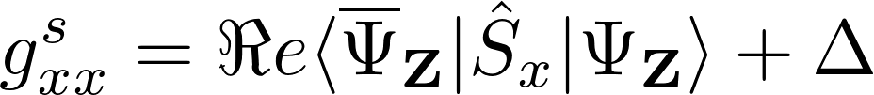
Consistent rotations
Should get the same g-tensor regardless of the orientation of the spin used in the calculation, e.g.,
Provided we correct for spin contamination this seems to work.

Slide 6
Consistent rotations
Should get the same g-tensor regardless of the orientation of the spin used in the calculation, e.g.,
Provided we correct for spin contamination this seems to work.
Will this correction still work if spin-orbit coupling is strong?

Slide 7
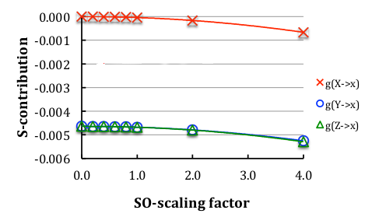
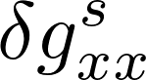
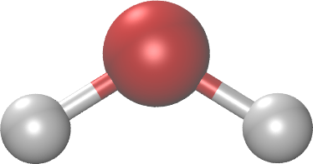
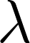
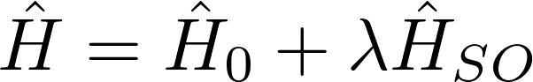
Adjustment applied to non-relativistic systems
In non-relativistic systems the approximation seems to work.
Variation in spin-Zeeman term with increasing
spin-orbit coupling.
H₂O⁺ (m=2)

Slide 8
Adjustment applied to non-relativistic systems
In non-relativistic systems the approximation seems to work.
Variation in spin-Zeeman term with increasing
spin-orbit coupling.
H₂O⁺ (m=2)

Slide 9
Adjustment applied to non-relativistic systems
In non-relativistic systems the approximation seems to work.
Variation in spin-Zeeman term with increasing
spin-orbit coupling.
H₂O⁺ (m=2)

Slide 10
Adjustment applied to non-relativistic systems
In non-relativistic systems the approximation seems to work.
Variation in spin-Zeeman term with increasing
spin-orbit coupling.
H₂O⁺ (m=2)

Slide 11
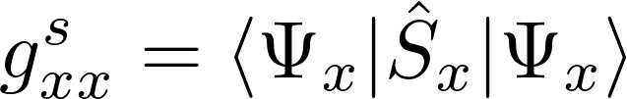
Adjustment applied to non-relativistic systems
In non-relativistic systems the approximation seems to work.
Variation in spin-Zeeman term with increasing
spin-orbit coupling.
H₂O⁺ (m=2)

Slide 12
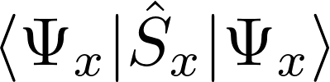
Adjustment applied to non-relativistic systems
In non-relativistic systems the approximation seems to work.
No K.P. spin rotation
Variation in spin-Zeeman term with increasing
spin-orbit coupling.
H₂O⁺ (m=2)

Slide 13
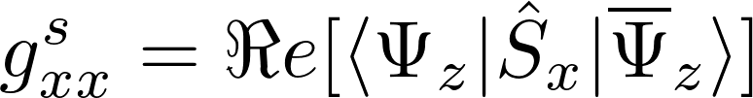
Adjustment applied to non-relativistic systems
In non-relativistic systems the approximation seems to work.
Variation in spin-Zeeman term with increasing
spin-orbit coupling.
H₂O⁺ (m=2)

Slide 14
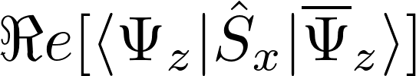
Adjustment applied to non-relativistic systems
In non-relativistic systems the approximation seems to work.
Variation in spin-Zeeman term with increasing
spin-orbit coupling.
H₂O⁺ (m=2)

Slide 15
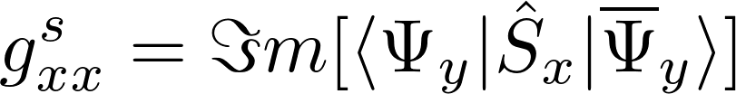
Adjustment applied to non-relativistic systems
In non-relativistic systems the approximation seems to work.
Variation in spin-Zeeman term with increasing
spin-orbit coupling.
H₂O⁺ (m=2)

Slide 16
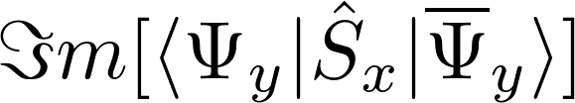
Adjustment applied to non-relativistic systems
In non-relativistic systems the approximation seems to work.
Variation in spin-Zeeman term with increasing
spin-orbit coupling.
H₂O⁺ (m=2)

Slide 17
Adjustment applied to non-relativistic systems
In non-relativistic systems the approximation seems to work.
K.P. Spin rotation
Variation in spin-Zeeman term with increasing
spin-orbit coupling.
H₂O⁺ (m=2)

Slide 18
Adjustment applied to non-relativistic systems
In non-relativistic systems the approximation seems to work.
No K.P. spin rotation
K.P. Spin rotation
Variation in spin-Zeeman term with increasing
spin-orbit coupling.
H₂O⁺ (m=2)

Slide 19
Adjustment applied to non-relativistic systems
In non-relativistic systems the approximation seems to work.
No K.P. spin rotation
Error due to K.P.
spin rotation
K.P. Spin rotation
Variation in spin-Zeeman term with increasing
spin-orbit coupling.
H₂O⁺ (m=2)

Slide 20

Adjustment applied to non-relativistic systems
In non-relativistic systems the approximation seems to work.
No K.P. spin rotation
K.P. Spin rotation
Variation in spin-Zeeman term with increasing
spin-orbit coupling.
H₂O⁺ (m=2)

Slide 21
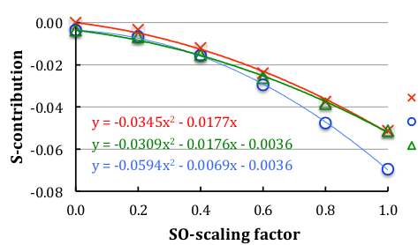
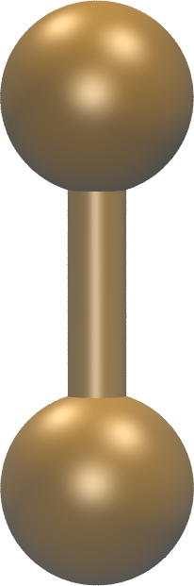
Adjustment applied to relativistic systems
The adjustment does not work for systems with strong spin-orbit.
I₂⁻ (m=2)
Variation in spin-Zeeman term with increasing
spin-orbit coupling.

Slide 22
Consistent rotations
Should get the same g-tensor regardless of the orientation of the spin used in the calculation, e.g.,
Provided we correct for spin contamination this seems to work.
Will this correction still work if spin-orbit coupling is strong?

Slide 23
Consistent rotations
Should get the same g-tensor regardless of the orientation of the spin used in the calculation, e.g.,
Provided we correct for spin contamination this seems to work.
Will this correction still work if spin-orbit coupling is strong?
No!

Slide 24
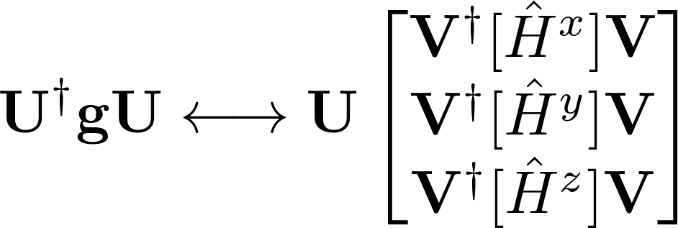
Consistent rotations
Mapping between g-tensor and spin-Hamiltonian:
U : real space rotation , V : spin space rotations

Slide 25
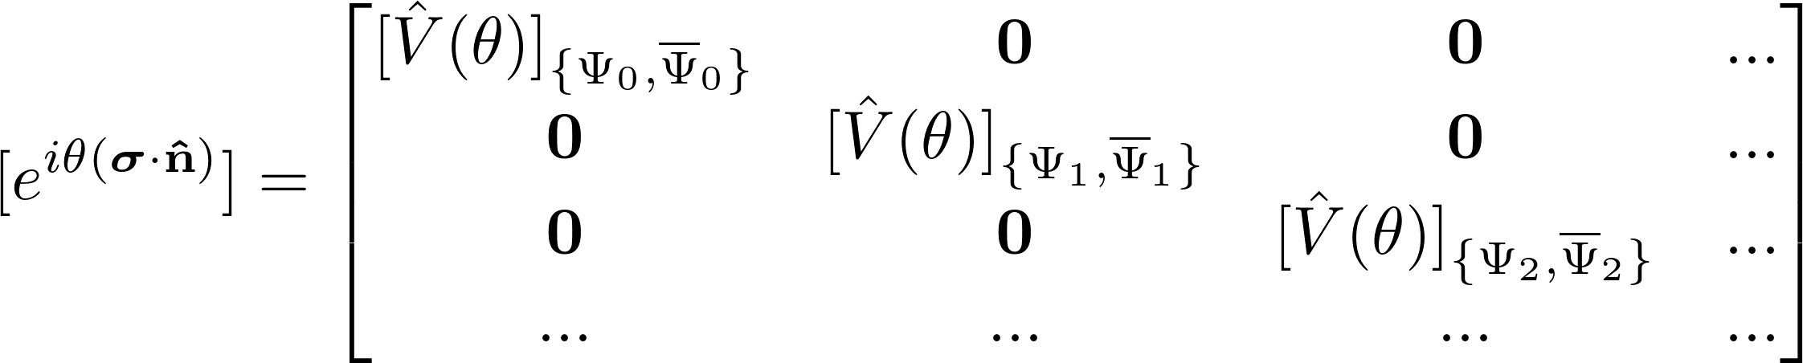
Spin rotations
Standard tensor approximations assume that different spin multiplets will not mix:
i.e., spin and spatial component are decoupled.

Slide 26
Consistent rotations
Mapping between g-tensor and spin-Hamiltonian:
U : real space rotation , V : spin space rotations
Does not work if spin-orbit coupling is strong!

Slide 27
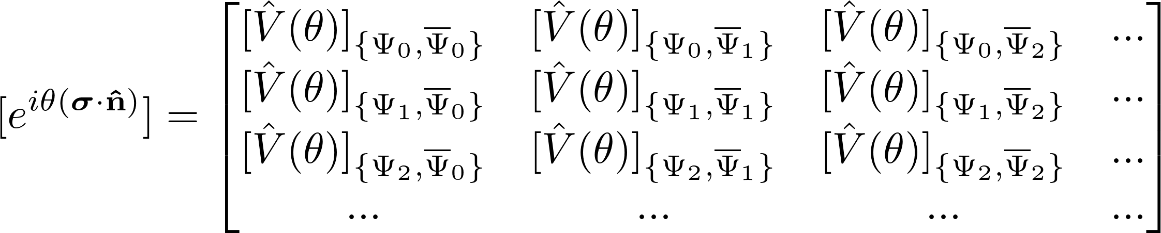
Spin rotations
In reality, electron spin cannot be transformed independently of the spatial components
i.e., different multiplets will mix together.

Slide 28
Orientations of spin magnetization
Wavefunction is not invariant under changes in the spin magnetization axis:
Magnetization direction | Total Energy (eV)
X | -14136.37547967025
Y | -14136.37547967033
Z | -14136.37556910989
Table 1: Energies obtained for different orientations of spin for HF calculations on I₂⁻. The bond is along the z-axis.
P. J. Cherry, V. G. Malkin, O. L. Malkina, J. R. Asher, JCP, (2016)

Slide 29
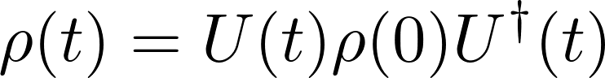
Density matrix approach
Define how the system evolves in time:

Slide 30
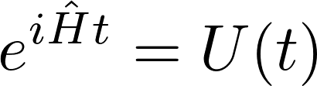
Density matrix approach
Define how the system evolves in time:
Determine this evolution from the Hamiltonian:

Slide 31
Density matrix approach
Define how the system evolves in time:
Determine this evolution from the Hamiltonian:
basis
restriction

Slide 32
Density matrix approach
Define how the system evolves in time:
Determine this evolution from the Hamiltonian:
Restriction of basis causes errors in systems with low lying spin states and strong spin-orbit coupling.
basis
restriction

Slide 33
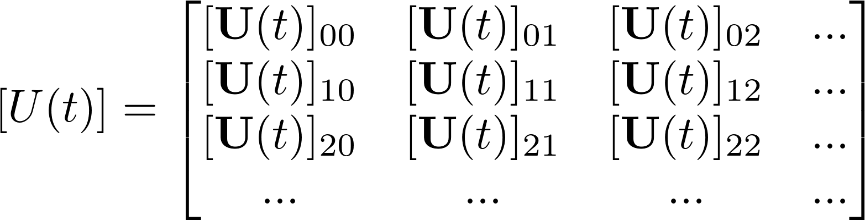
Time evolution with g-tensor
Restrict time evolution to ground state:
Ignore everything above the ground state multiplet!

Slide 34
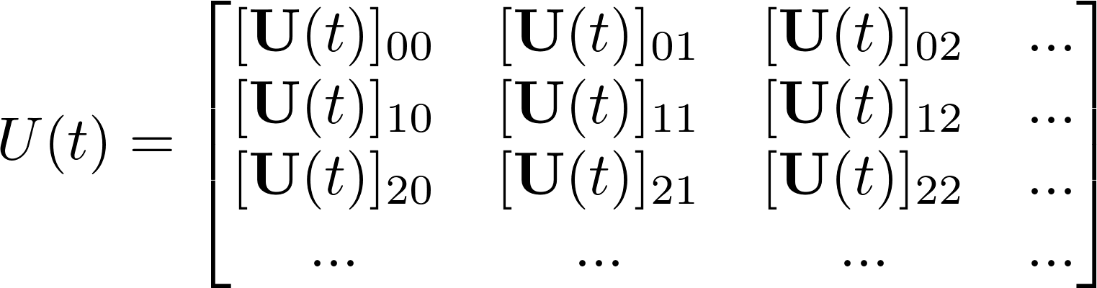
Time evolution in extended framework
Include excited states in time evolution:
Red blocks correspond to forbidden transitions.

Slide 35
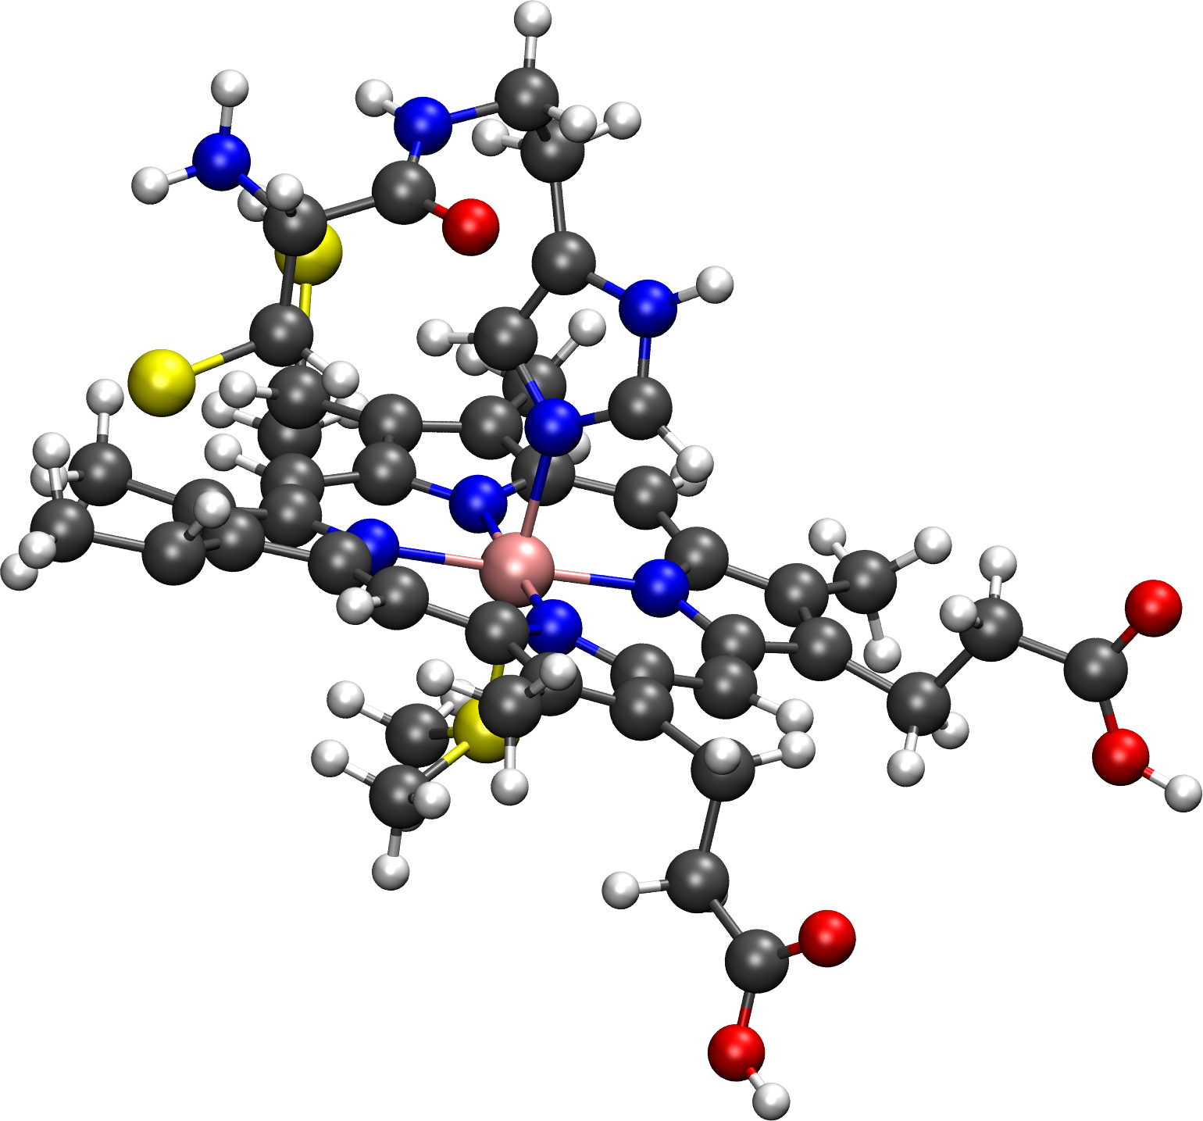
Advantages of extended framework
Can describe mixing of multiplets and systems with low lying excited states.
Protein pNMR experiments are often be performed at temperatures >> 0K.
Population of excited states complicates spectral analysis and prediction.
Cytochrome c fragment from X-ray geometry. Calderone group, CERM, unpublished.

Slide 36
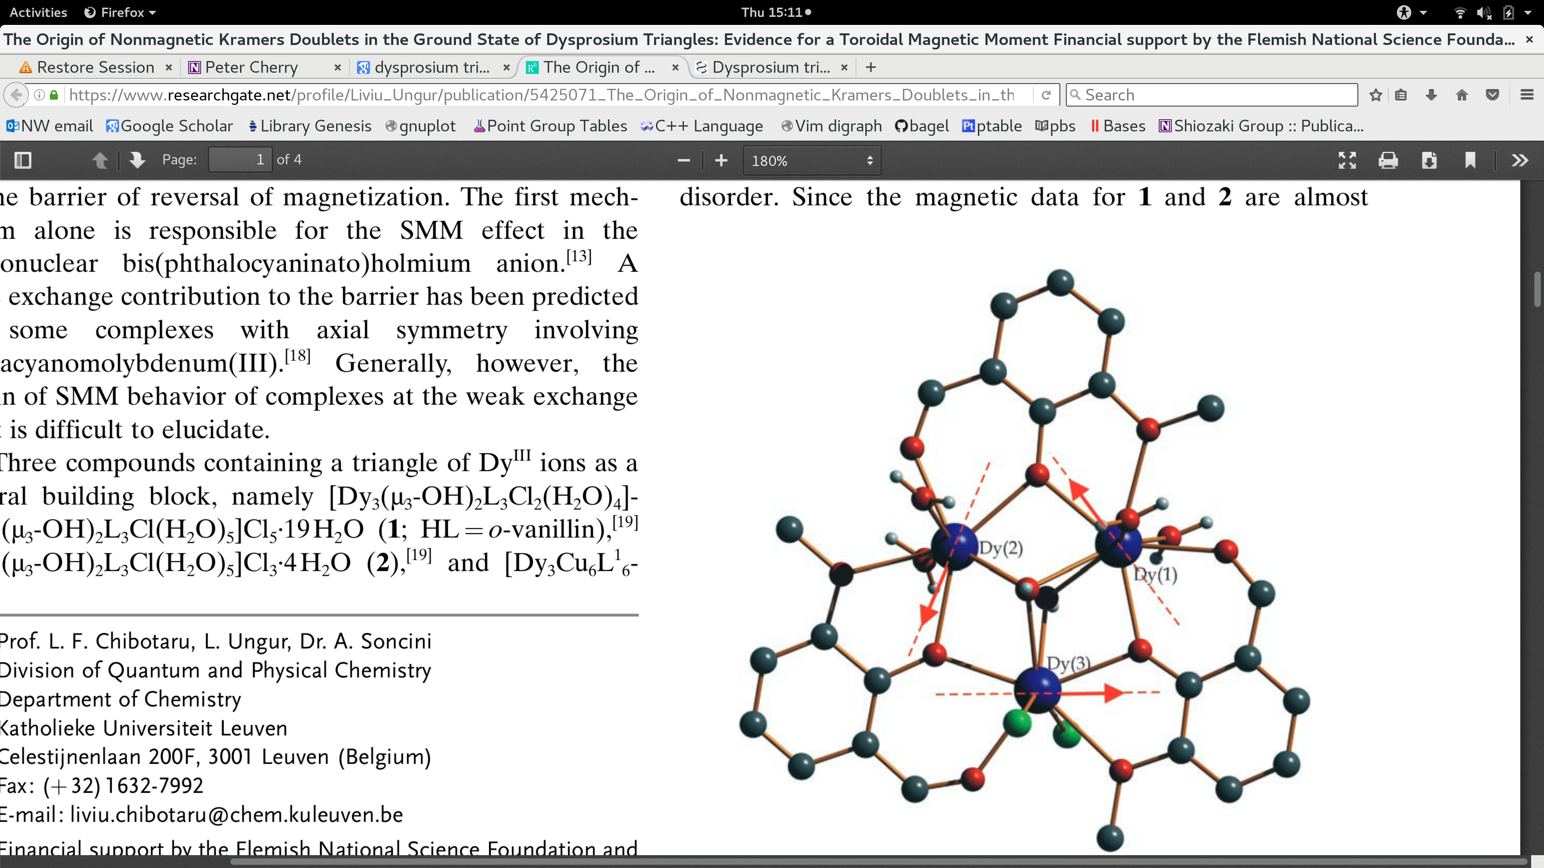
Advantages of extended framework
Synthesis : J. Tang, I Hewitt, N. T. Madhu, G Chastanet, W. Wernsdorfer, C. E. Anson, C. Benelli, R. Sessoli, and A. Powell, Angewandte Chemie International Edition, (2006)
Theory : L. Chibotaru, L. Ungur, and A.Soncini. Angewandte Chemie (2008)
Multiple spin centres.
Significant spin-orbit coupling.
Unusual symmetry.

Slide 37
G-tensor theory and strong spin-orbit coupling
Q) How well is g-tensor theory adapted to cases with strong spin-orbit coupling?

Slide 38
G-tensor theory and strong spin-orbit coupling
Q) How well is g-tensor theory adapted to cases with strong spin-orbit coupling?
A) In systems with large, anisotropic spin orbit coupling it breaks down, and density matrix based approaches could be useful.

Slide 39
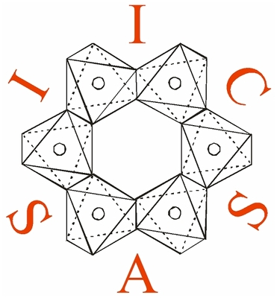
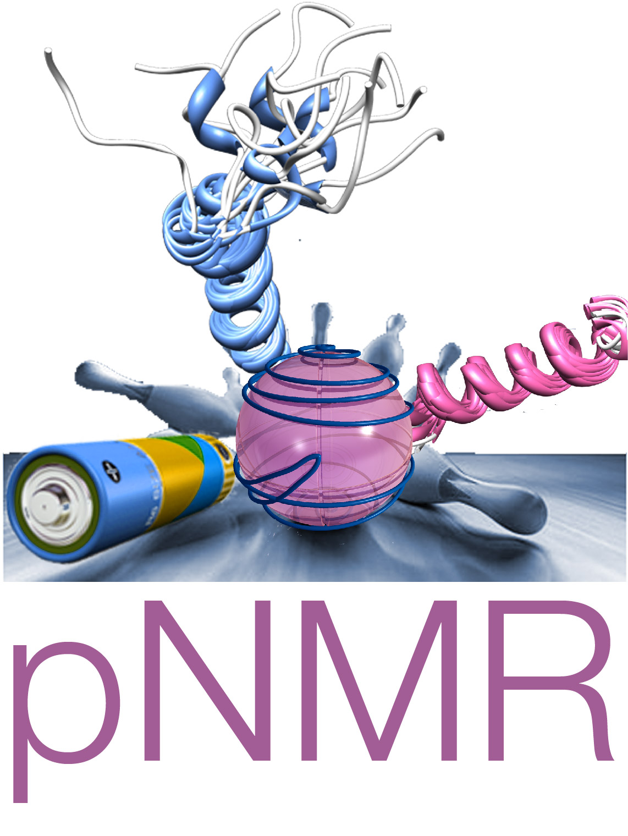


Acknowledgments
People
Prof. Vladimir Malkin and Prof. Olga Malkina (Bratislava).
Dr. Stanislav Komorovský (TromsØ).
Prof. Micheal Odelius and Prof. Jozef Kowalewskii (Stockholm).
Prof. Juha Vaara (Oulu).
Prof. Giacomo Parigi, Prof. Claudio Luchinat, Dr. Enrico Ravera (Florence).
Prof. Toru Shiozaki and group (Northwestern).
Funding
The research leading to these results has received funding from the People Programme (Marie Curie Actions) of the European Union's Seventh Framework Programme (FP7/2007-2013) under REA grant agreement n°317127.

